Slide 1


NASDAQ: PYPL

Slide 2

01
Company Description

Slide 3
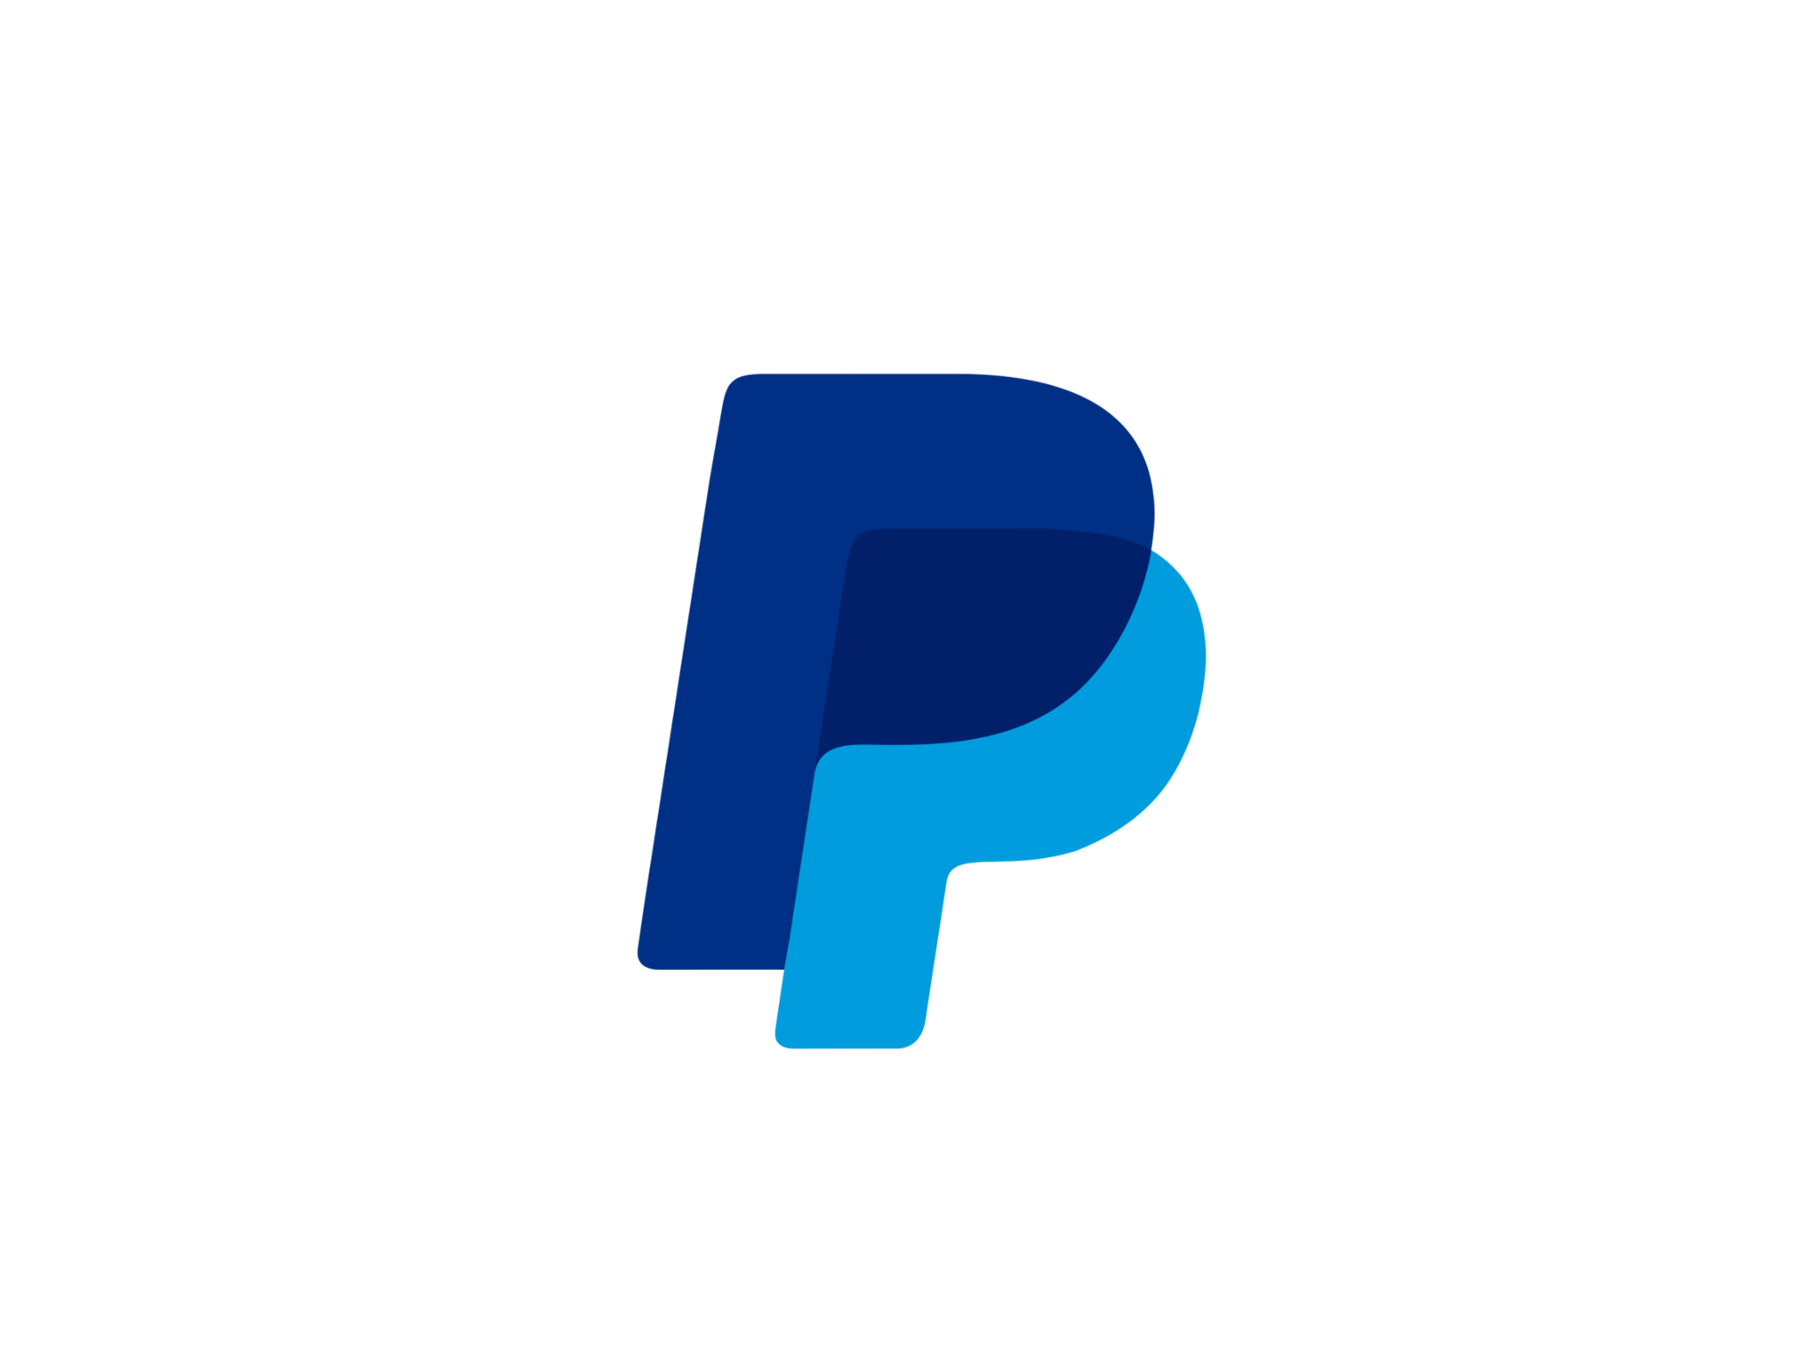
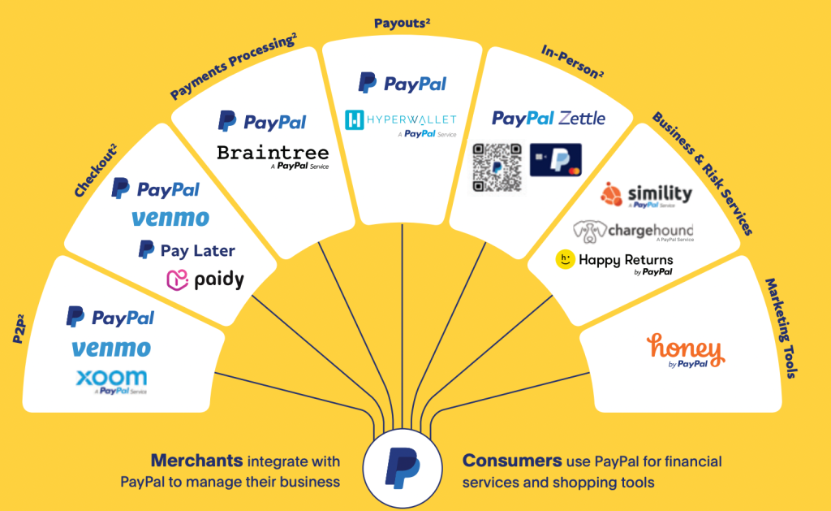
Company Description
PayPal is a global payments platform that lets consumers and merchants send, spend, and accept money online, in-app, and in-store.
Its brands include PayPal and Venmo, Braintree Complete Payments, PayPal Pay in 4, Zettle, Xoom, and shopping tools from Honey.
PayPal earns mainly transaction fees plus value-added services (fraud/risk, payouts, FX, and merchant tools).
As of year-end 2024, PayPal reported $31.8B in revenue and $1.68T in total payment volume across 434M active accounts.
Their headquarters are located in San Jose, CA. Their CEO is Alex Chriss who has been in his position since Sept. 27, 2023.

Slide 4
01
Industry Analysis

Slide 5
Industry Analysis
The fintech and digital payments industry is extremely competitive, with PayPal having direct competition from Venmo, Zelle, and others
Due to customers having the ability to easily switch between payment platforms competition is fierce
Despite this, PayPal benefits from strong brand trust and wide product set, which help it retain users in a crowded market
However, rivalry continues to limit margins, and PayPal’s challenge is maintaining profitability while competing against low-cost, high-growth peers across the payments landscape

Slide 6
02
Competitive Analysis

Slide 7

Competitive Analysis (Porter’s 5)
Competitive Rivals
Threat of New Entrants
Rivals consist of players within the fintech industry; BNPL (buy now, pay later) services
  Stripe, Square, Apple/Google Pay
  Banks and credit card providers as payment services
Rivalry driven by low cost for switching services
Threat of declining market share → stays relevant through R&D and brand recognition
Overall competition is very high within industry and sector
Highly regulated sector (government regulation) → high barriers to entry
Expensive technological infrastructure and security
Bigger companies have foothold on industry
Overall low-mid threat of new entrants

Slide 8
Competitive Analysis (Porter’s 5)
Bargaining Power of Buyers
Bargaining Power of Suppliers
Threat of Substitutes
Buyers: users of PayPal
Many alternatives to PayPal (Stripe, Square, credit cards, Apple/Google Pay)
Low costs for buyers to switch services
Strong competition for PayPal
Overall high bargaining power for buyers
Suppliers include credit card providers (Visa, AmEx, Mastercard)
Brand recognition puts PayPal in good standing with suppliers
Safety and fraud risk suppliers = critical; high power over PayPal
Overall moderate bargaining power for suppliers
Aligns with bargaining power of buyers
  Many alternatives available; low switching costs
New alternatives within industry (crypto)
Growing competition
Overall high (and growing) threat of substitutes

Slide 9
05
Risks and Mitigants

Slide 10
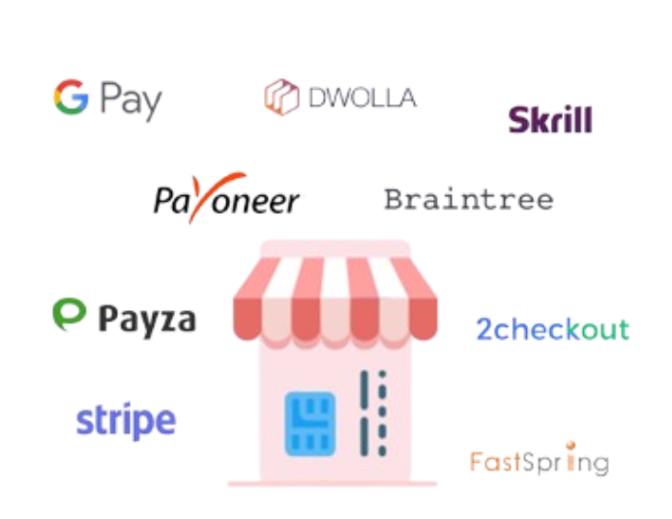
Competitive Pressures
Risk: Competitive Landscape
Increasing competition from Apple Pay, Google Pay, Stripe, and Block
Mobile wallets gaining share, reducing PayPal’s role in checkout
Mitigant: Platform Improvements
Consolidating Braintree, Hyperwallet, and merchant tools into a unified platform
Launch of Fastlane and upgraded guest checkout to reduce friction

Slide 11
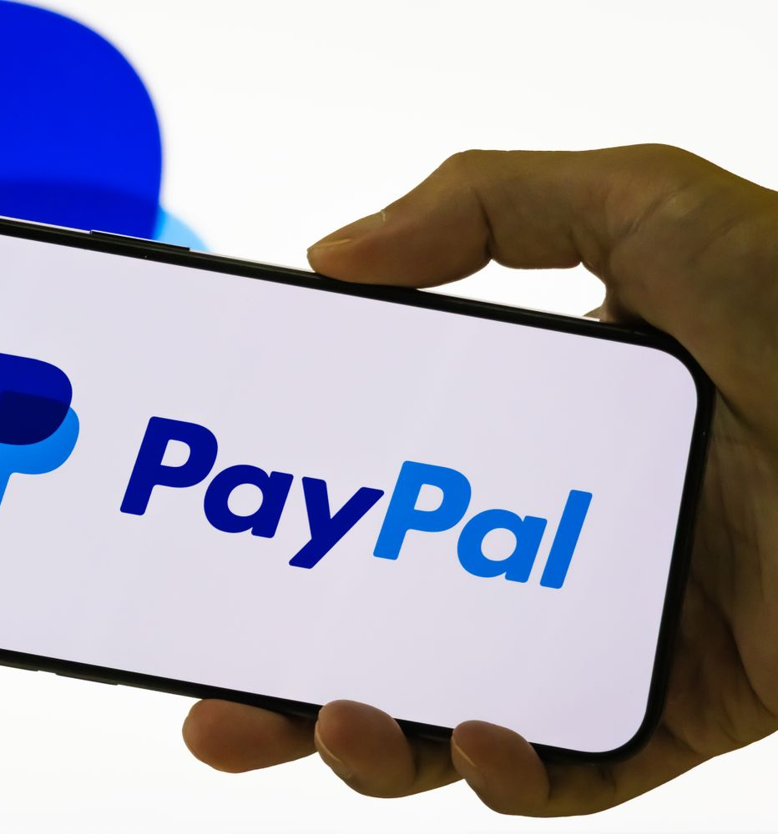
Macroeconomic Sensitivity
Risk: Sensitive Macroeconomic
Slower consumer spending and inflation can reduce PayPal’s transaction volume.
Mitigant: Financial & Operational Resilience:
PayPal benefits from higher interest rates through increased earnings on customer balances
The company is tightening costs and improving operational efficiency

Slide 12
02
Investment
Thesis

Slide 13



→ Buy PayPal
#1
#2
#3
Profit Growth Driven by Efficiency
Strong, More Connected Platform
New Growth Opportunities: Venmo + International Markets
Notes:
Profit Growth Driven by Efficiency
Profit growth now outpacing revenue growth due to major cost-cutting initiatives
Actions taken: workforce reductions, shutdown of underperforming products (e.g., PayPal Rewards), infrastructure optimization
These changes are expanding operating margins and boosting EPS
Management guiding 20%+ GAAP EPS growth in 2025
PayPal is positioned to deliver earnings growth ahead of revenue over the next 2–3 years
Strong, More Connected Platform
PayPal is consolidating payments, fraud protection, financing, and identity tools into PayPal Open
Creates a single, integrated system for both consumers and businesses
Benefits: better conversion rates, fewer fraud losses, faster and easier onboarding
PayPal Complete Payments (PCP) is gaining traction with small businesses
Platform upgrades expected to improve customer retention and increase usage
New Growth Opportunities: Venmo + International Markets
Venmo is still early in monetization, especially in business payments and online checkout
Growth drivers: Venmo Business Profiles, Pay with Venmo, rising adoption among merchants
International expansion in Germany, Brazil, and other markets with growing branded checkout and BNPL demand
PayPal’s global merchant relationships create potential for Venmo features to scale internationally
Represents a long-term opportunity for sustained revenue and earnings growth

Slide 14

Profit Growth Driven by Efficiency
01
Profit growth now outpacing revenue growth due to major cost-cutting initiatives
Actions taken: workforce reductions, shutdown of underperforming products (e.g., PayPal Rewards), infrastructure optimization
These changes are expanding operating margins and boosting EPS
Management guiding 20%+ GAAP EPS growth in 2025
PayPal positioned to deliver earnings growth ahead of revenue over the next 2–3 years

Slide 15
Strong, More Connected Platform
02
PayPal consolidating payments, fraud protection, financing, and identity tools into PayPal Open
Creates a single, integrated system for both consumers and businesses
Benefits: better conversion rates, fewer fraud losses, faster and easier onboarding
PayPal Complete Payments (PCP) gaining traction with small businesses
Platform upgrades expected to improve customer retention and increase usage

Slide 16

New Growth Opportunities: Venmo + International Markets
03
Venmo still early in monetization, especially in business payments and online checkout
Growth drivers: Venmo Business Profiles, Pay with Venmo, rising adoption among merchants
International expansion in Germany, Brazil, and other markets with growing branded checkout and BNPL demand
PayPal’s global merchant relationships create potential for Venmo features to scale internationally
Represents a long-term opportunity for sustained revenue and earnings growth

Slide 17
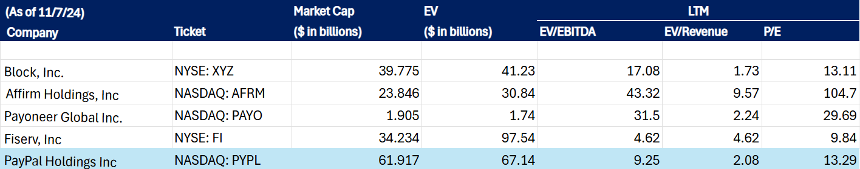
Comparisons

Slide 18
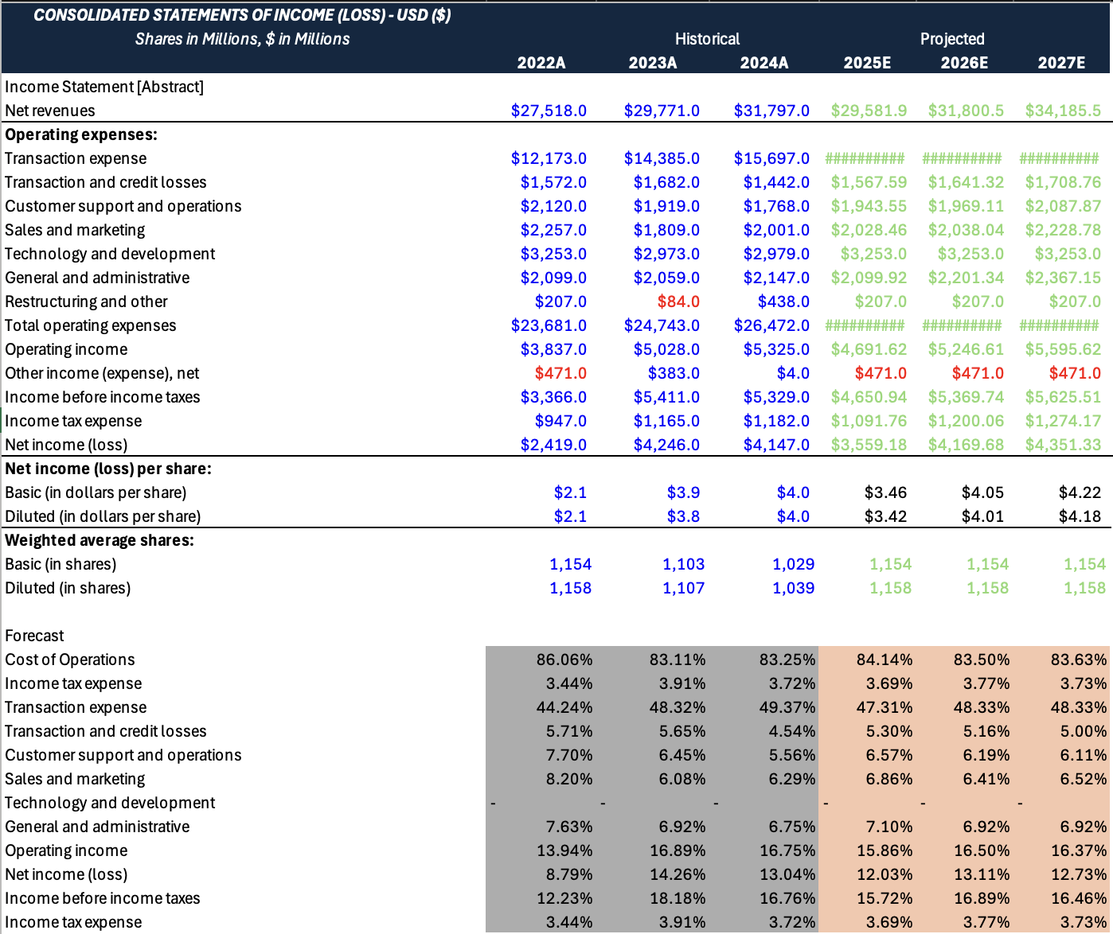
Income Statement

Slide 19
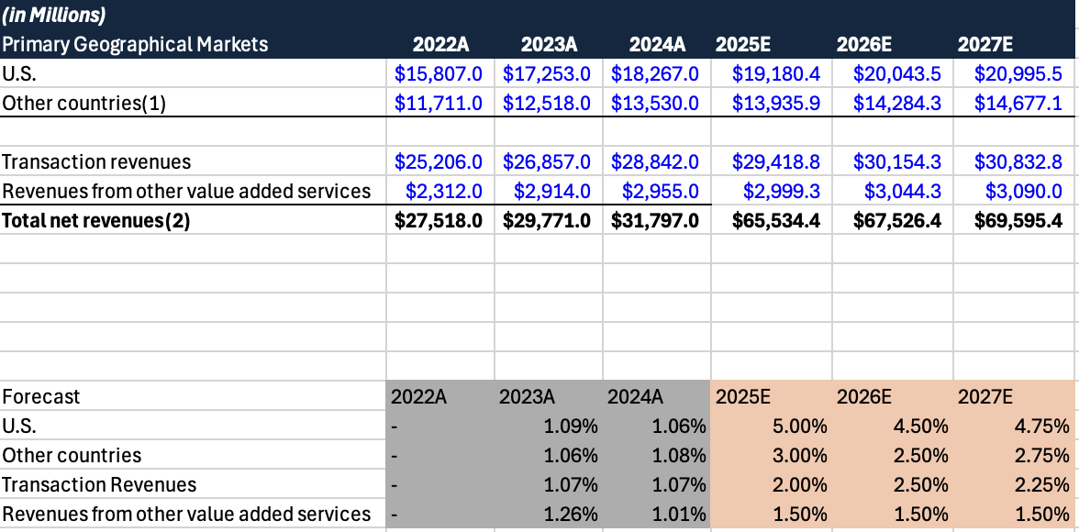
Revenue Buildout

